Slide 1

Course Details
DevOps with AWS

Slide 2
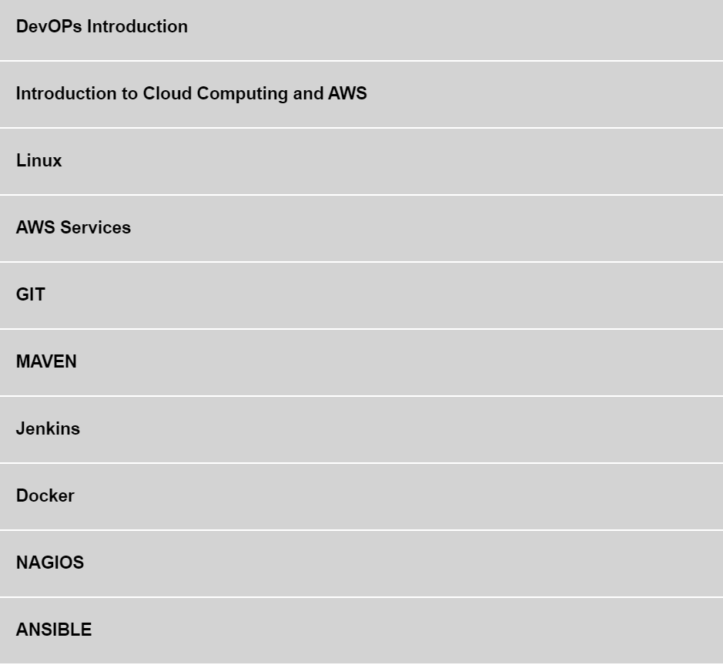

Slide 3
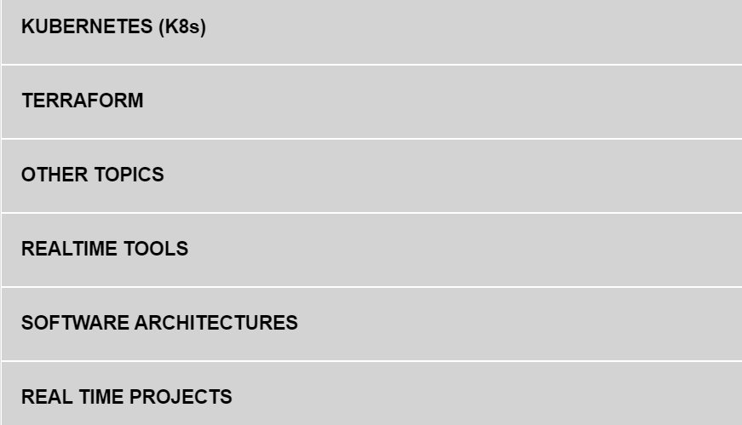

Slide 4

SDLC
What is SDLC?
The Software Development Life Cycle (SDLC) is a well-defined procedure for producing high-quality, low-cost software in the shortest amount of time possible. The SDLC's purpose is to create exceptional software that exceeds all customer expectations and demands. The SDLC develops and describes a detailed plan that includes stages, or phases, each with its own process and deliverables. It describes the entire development process, including all tasks involved in planning, developing, testing, and distributing a software product.

Slide 5
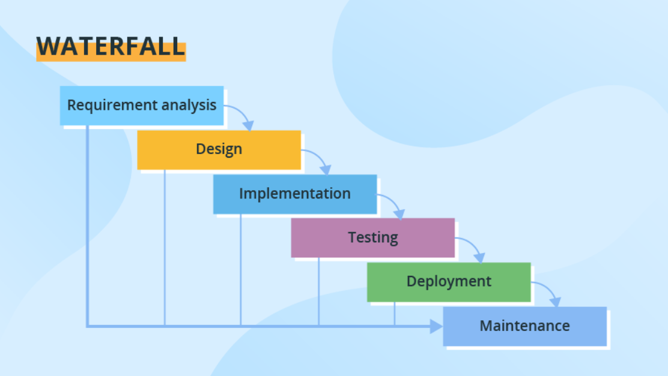

Slide 6
Waterfall model
The waterfall model follows a linear and sequential approach to software development.
It consists of distinct phases, such as requirements gathering, design, implementation, testing, deployment, and maintenance.
Each phase is completed before moving on to the next, making it a rigid and structured model.

Slide 7
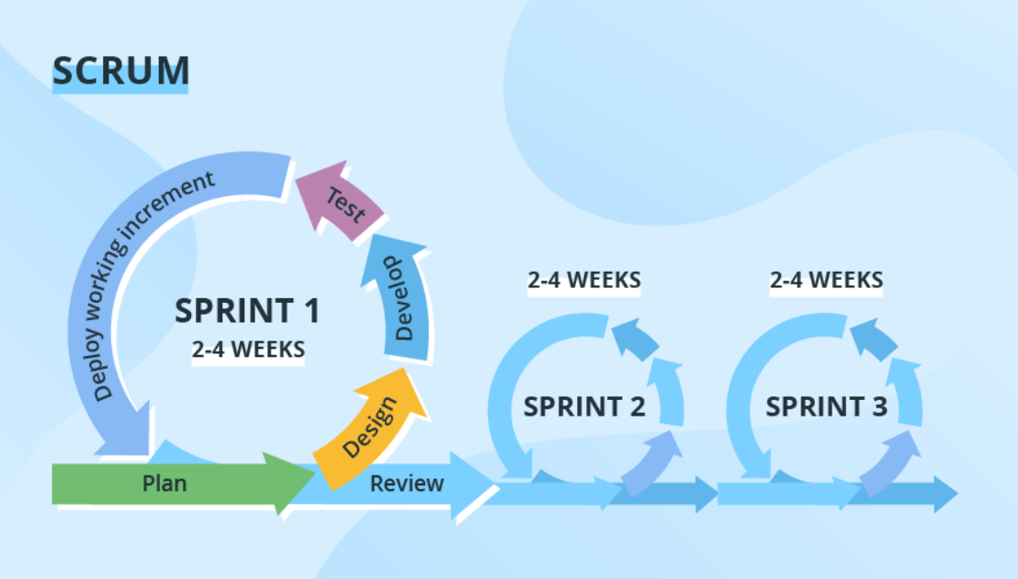

Slide 8
Agile or scrum Model:
Agile is an iterative and incremental SDLC model that emphasizes flexibility, collaboration, and rapid delivery.
It involves breaking the development process into small iterations called sprints, where requirements, development, and testing occur concurrently.
Agile methods, such as Scrum and Kanban, promote adaptive planning and regular customer feedback.

Slide 9
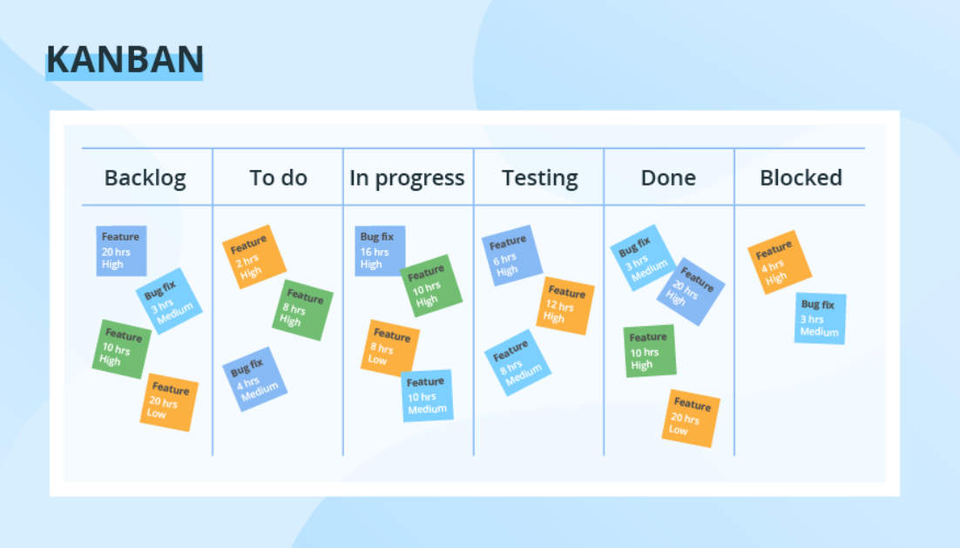

Slide 10
Kanban model
Kanban is a project management method that originated in the manufacturing industry but has been widely adopted in software development and other knowledge work domains.
It provides a visual framework for managing tasks and workflows, promoting efficiency, transparency, and continuous improvemen

Slide 11
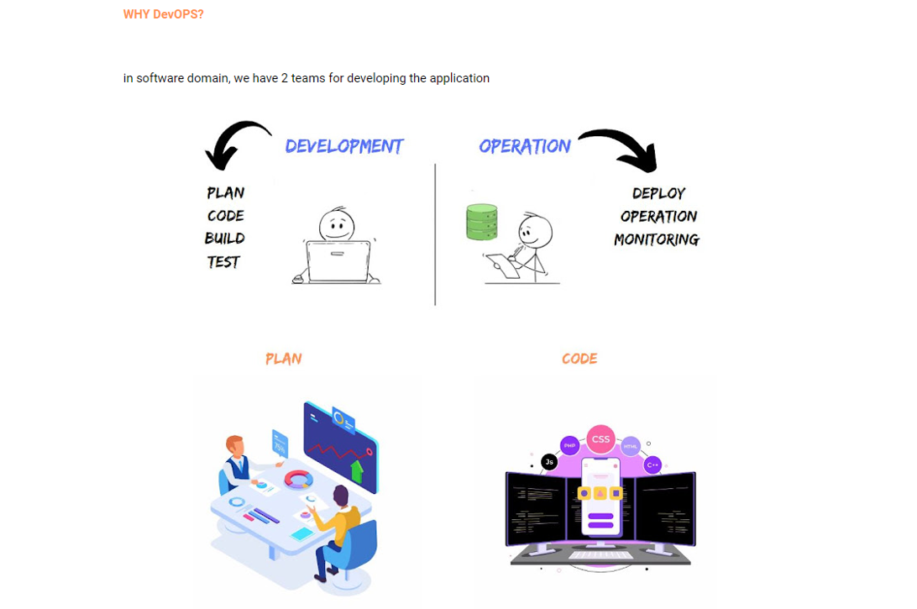

Slide 12
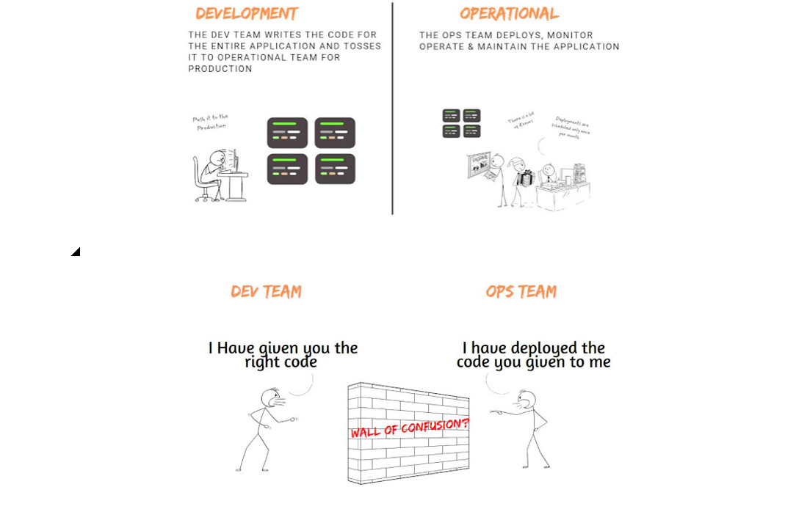

Slide 13
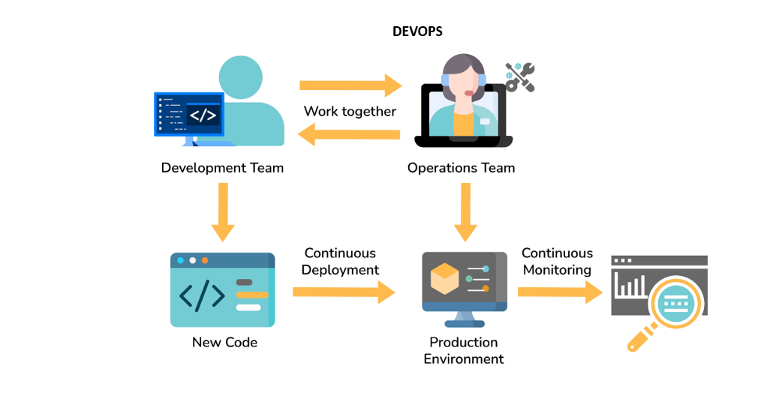

Slide 14
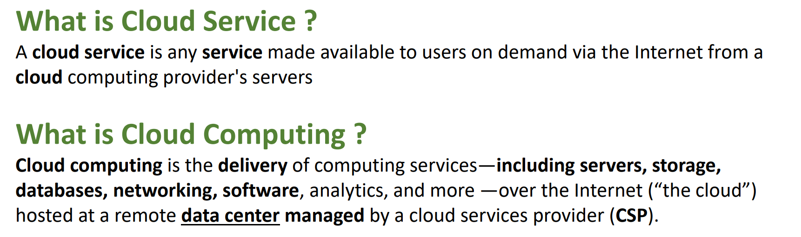

Slide 15
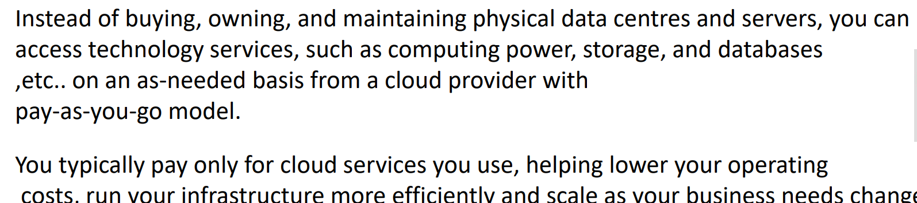

Slide 16
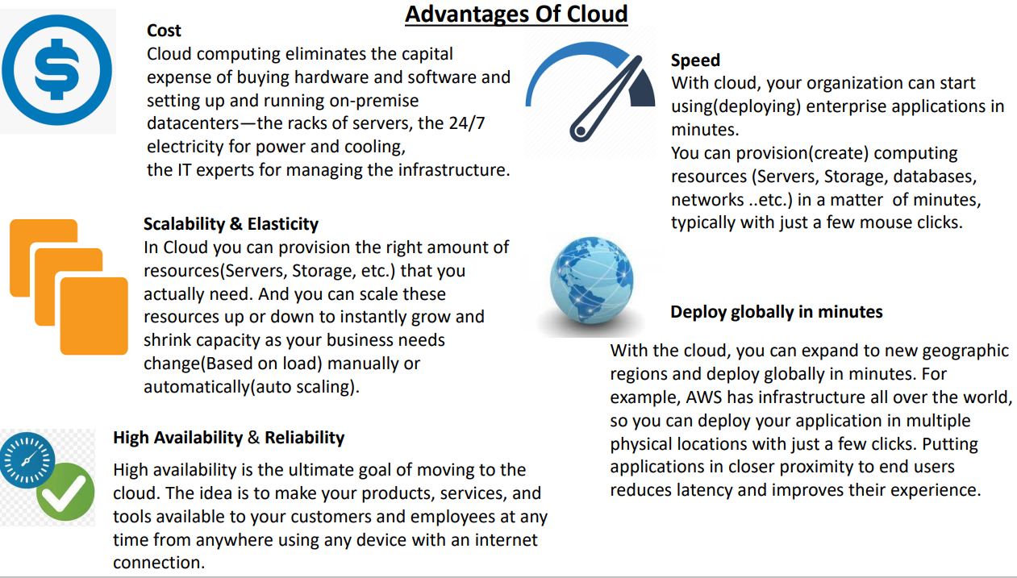

Slide 17
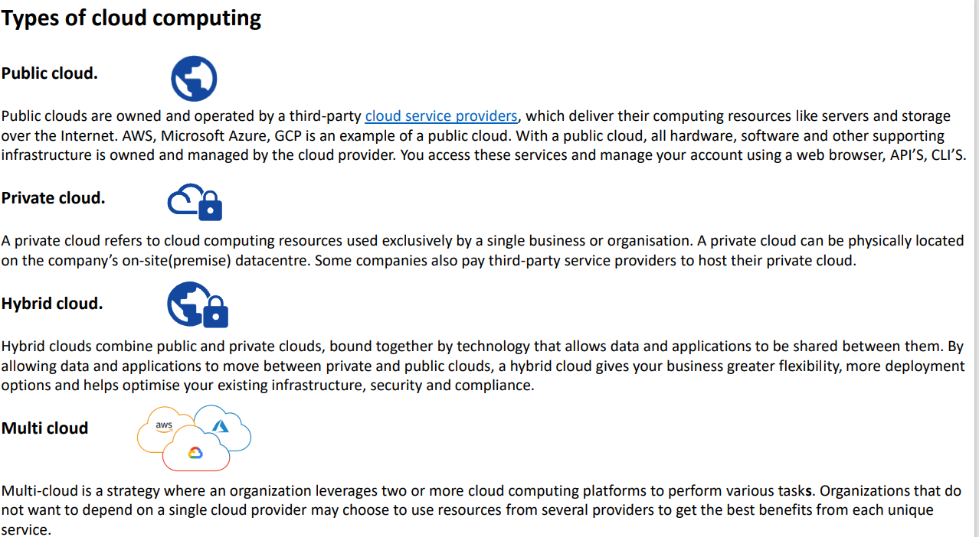

Slide 18
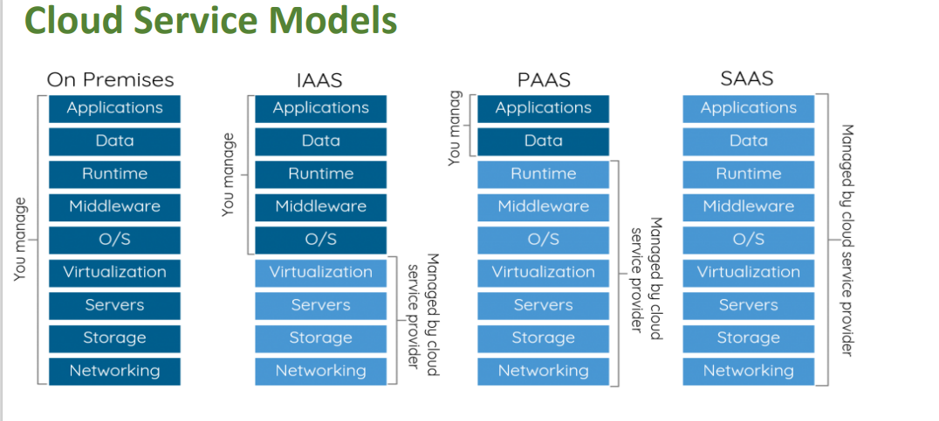

Slide 19
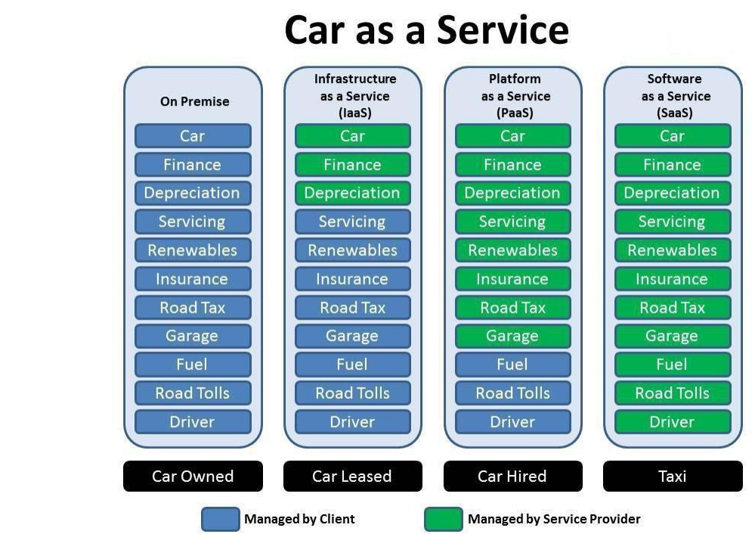

Slide 20
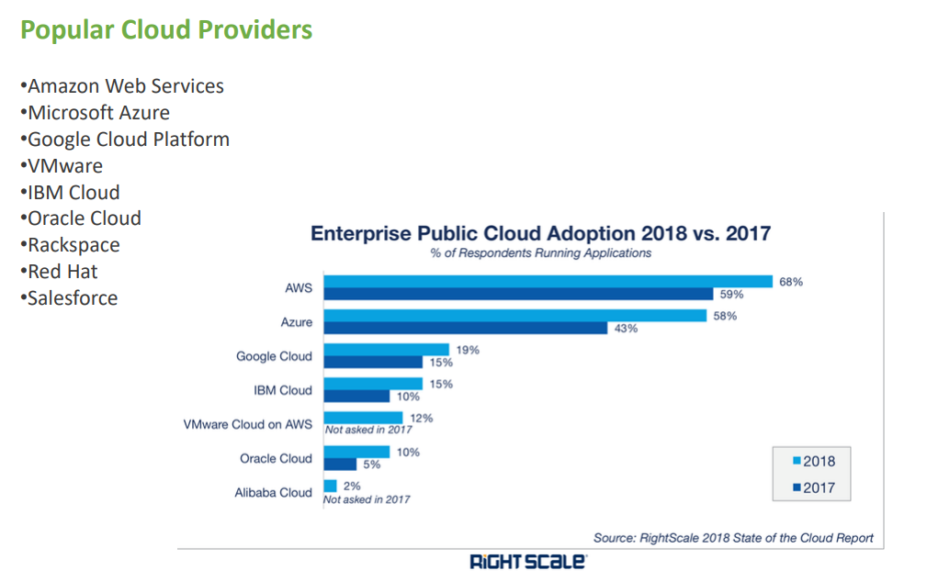

Slide 21



Slide 22
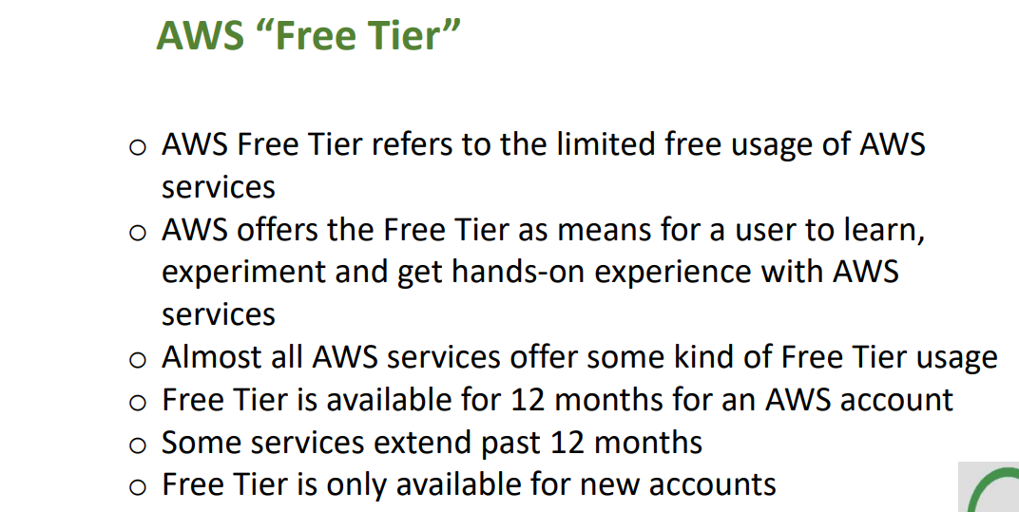

Slide 23
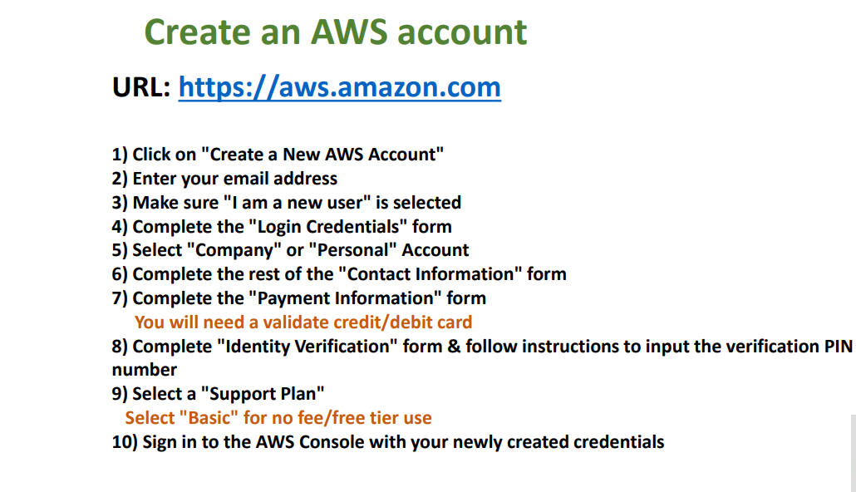

Slide 24
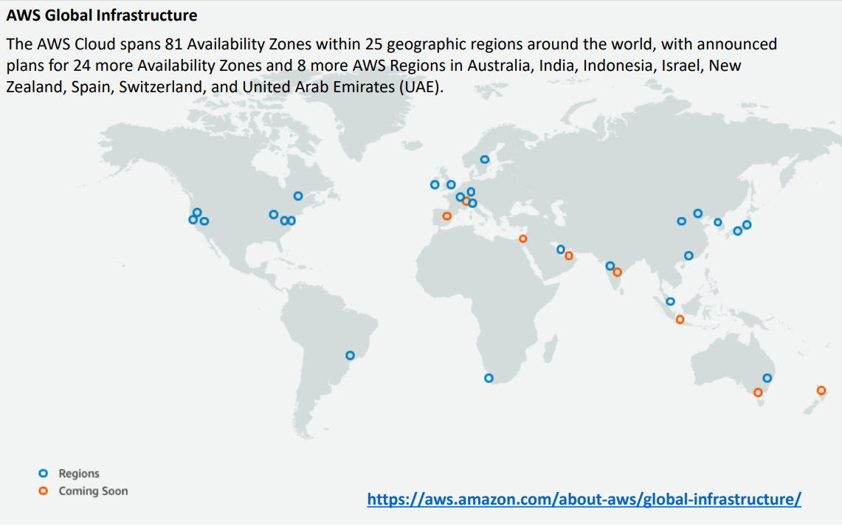

Slide 25
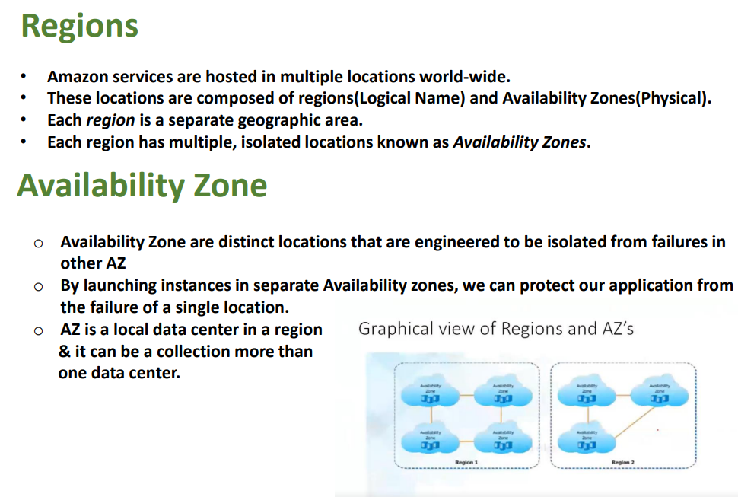

Slide 26
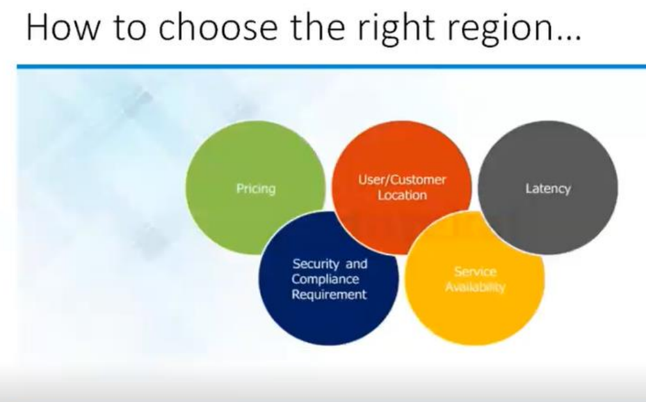

Slide 27
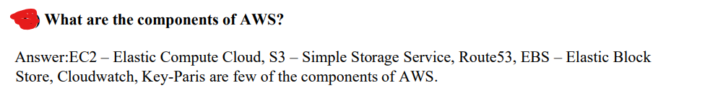

Slide 28
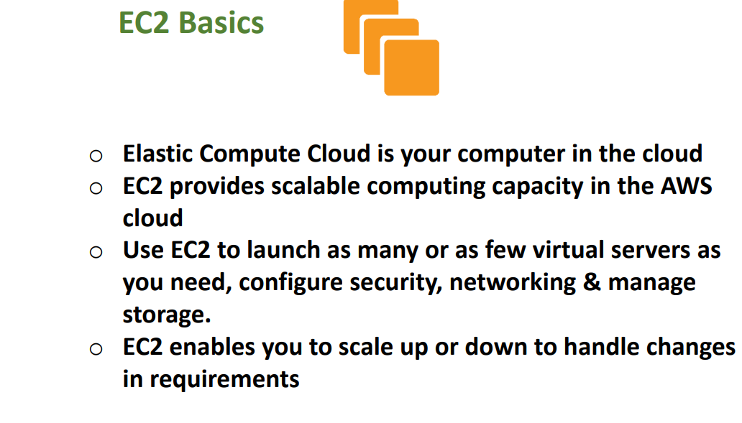

Slide 29
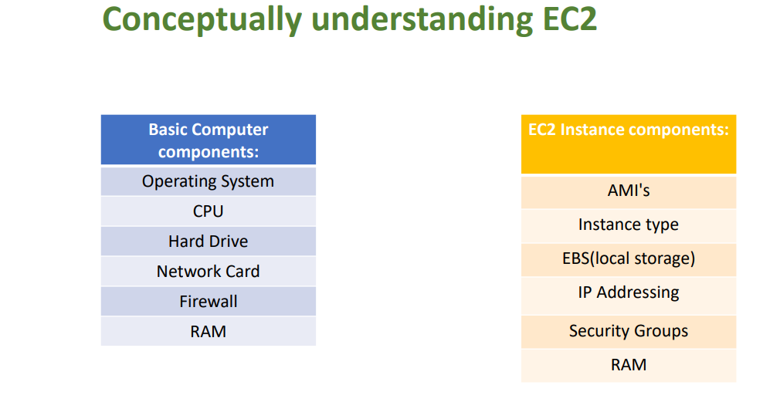

Slide 30
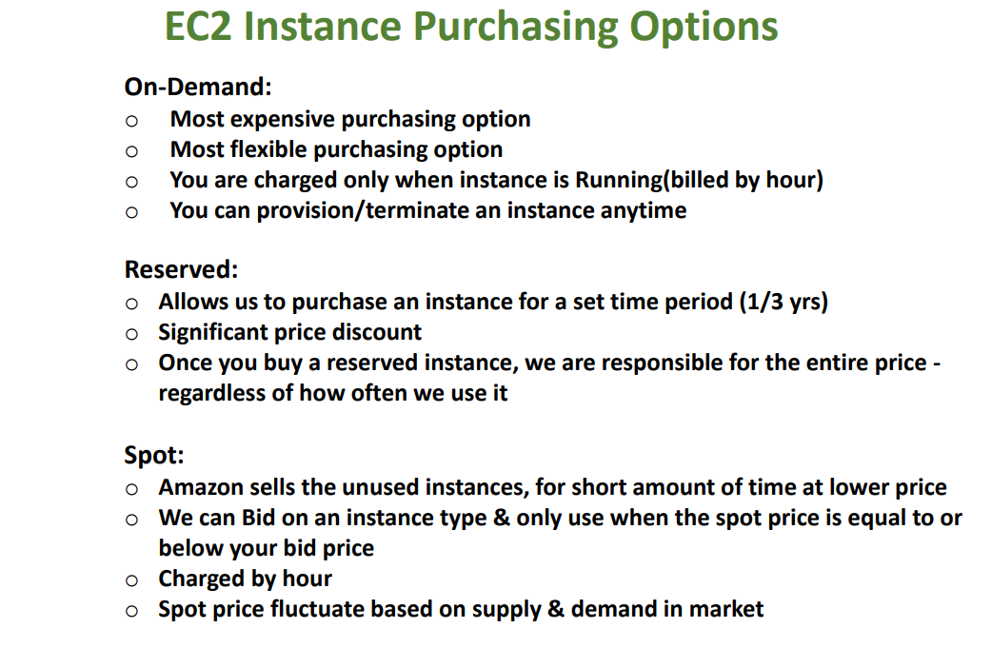

Slide 31
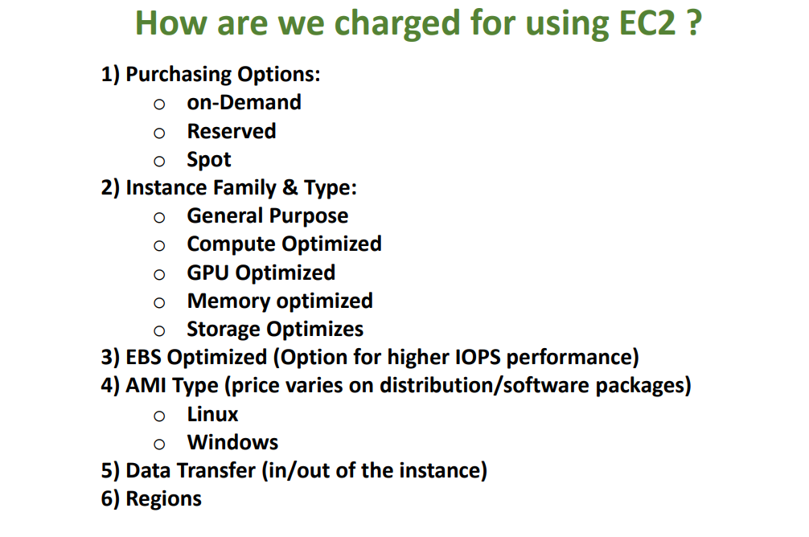

Slide 32
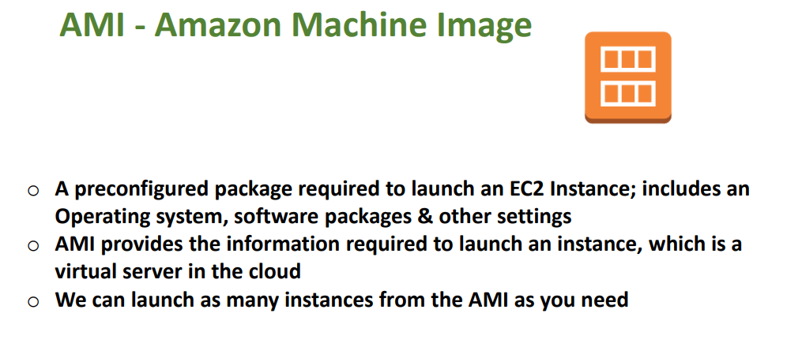

Slide 33
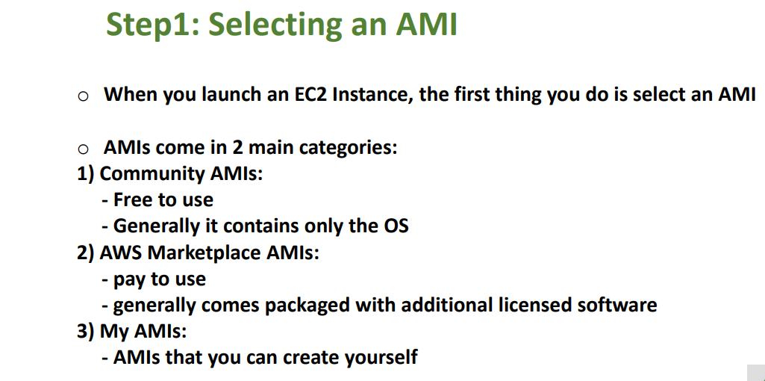

Slide 34
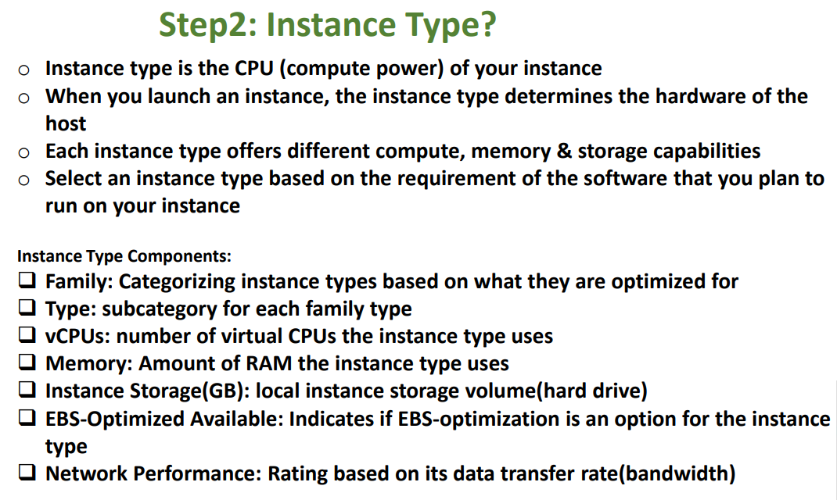

Slide 35
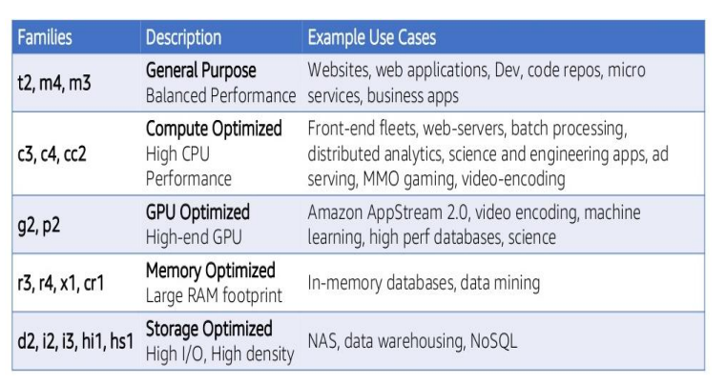

Slide 36
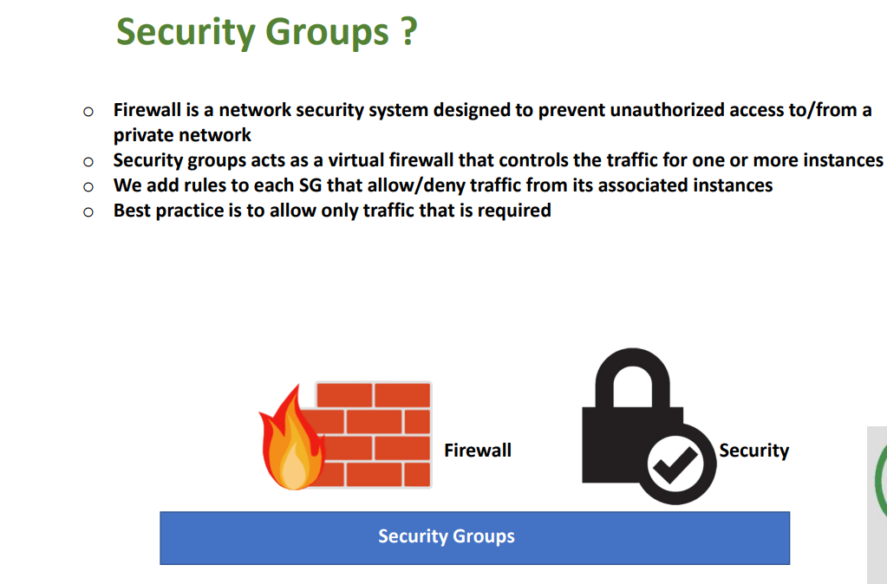

Slide 37
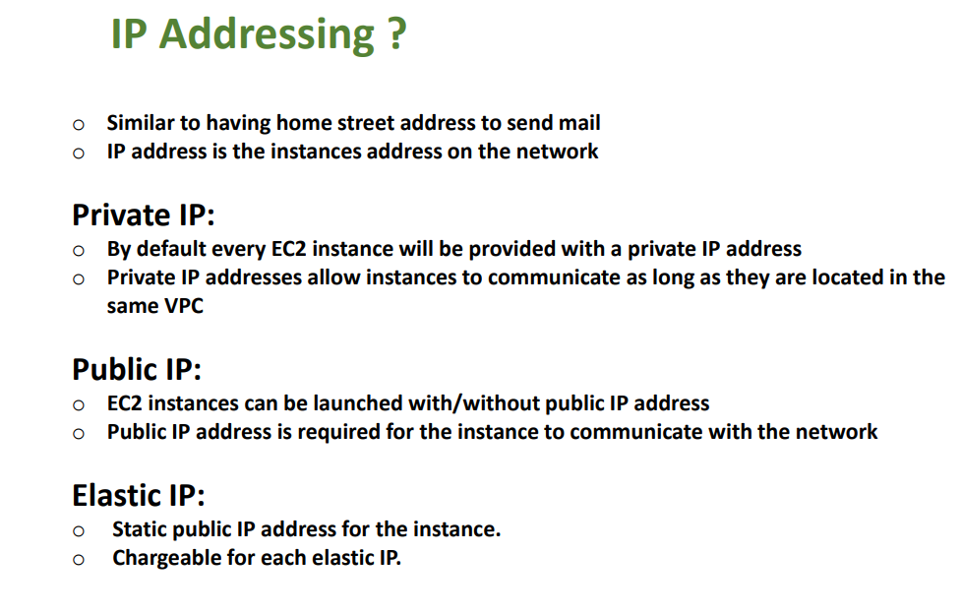

Slide 38
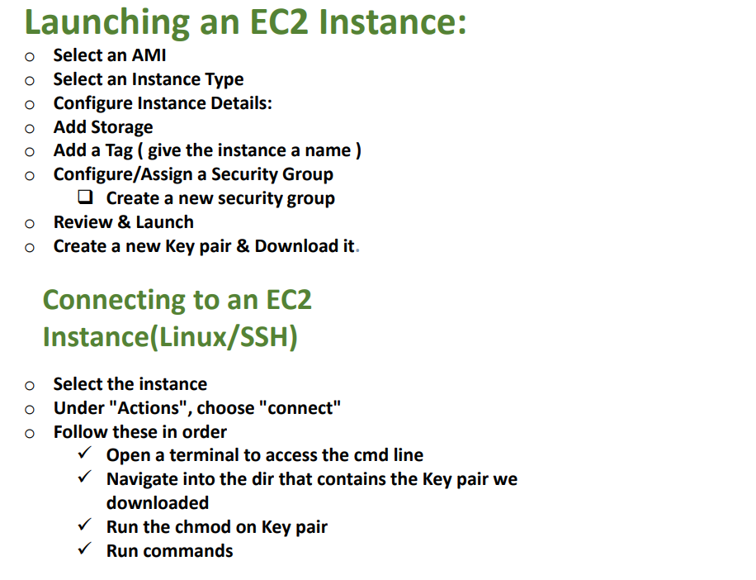

Slide 39
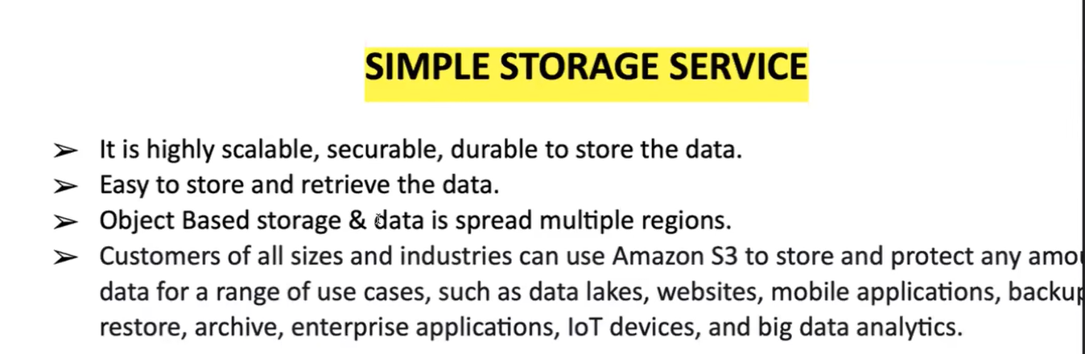

Slide 40
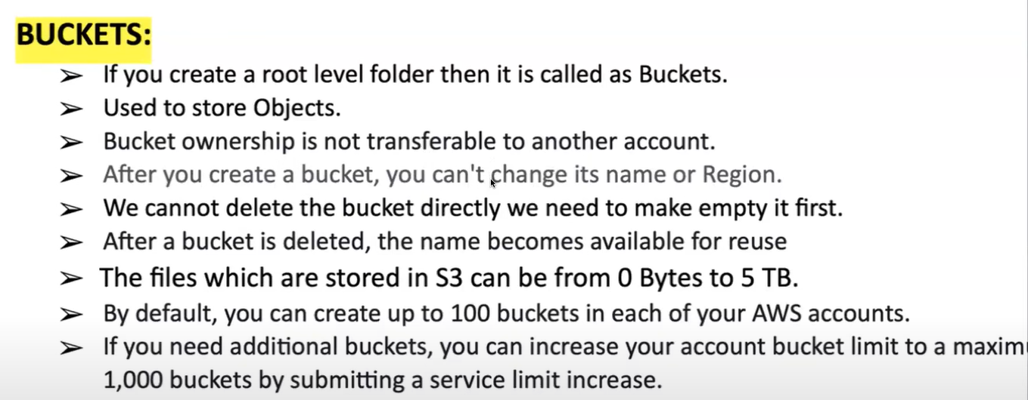

Slide 41
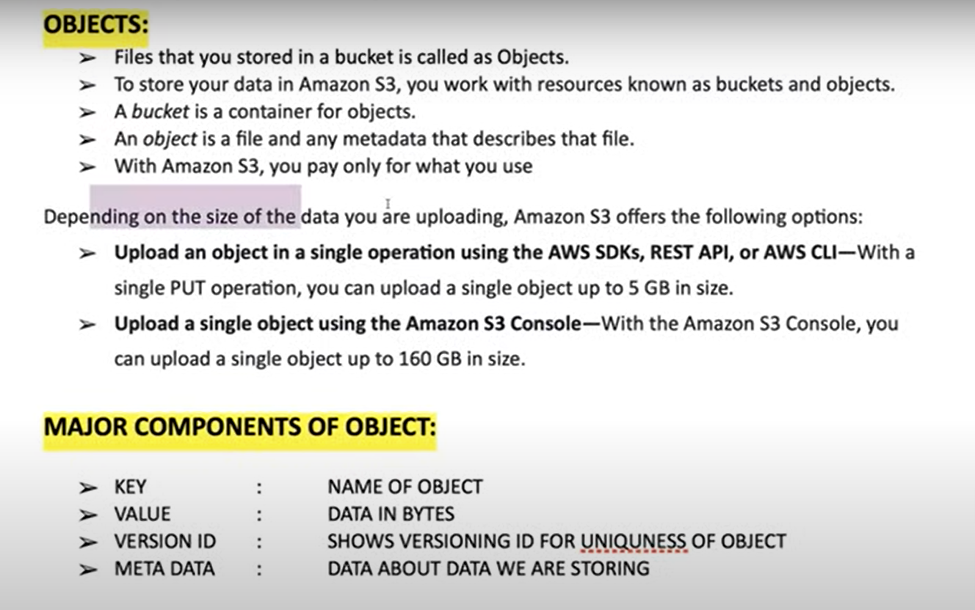

Slide 42
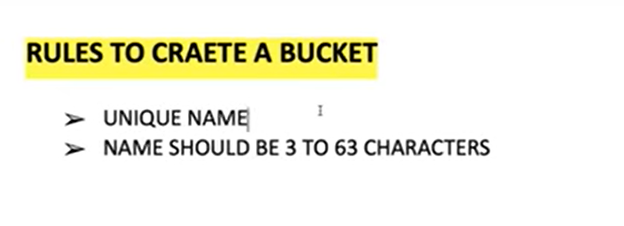

Slide 43
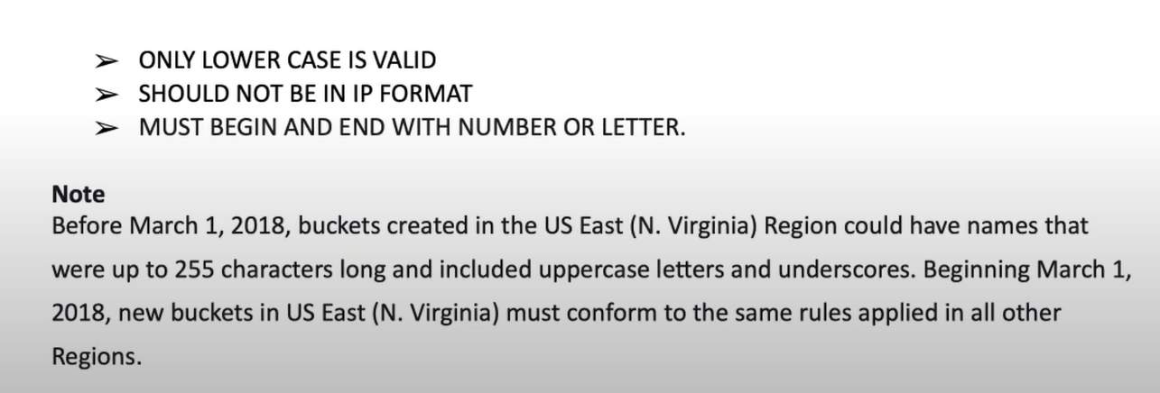

Slide 44
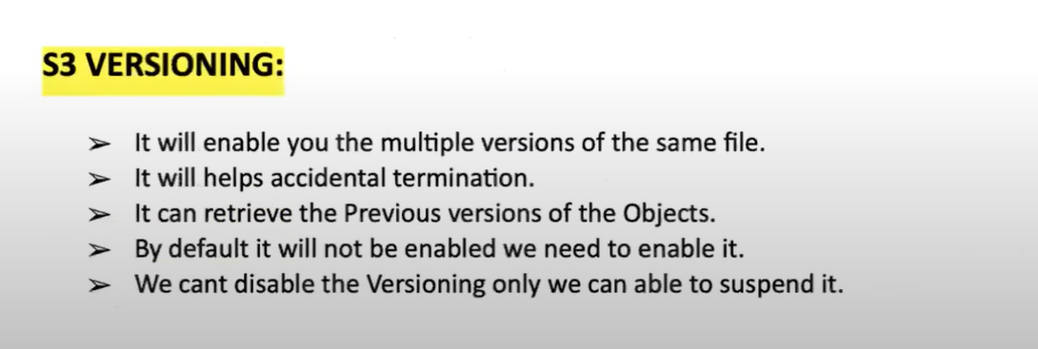

Slide 45
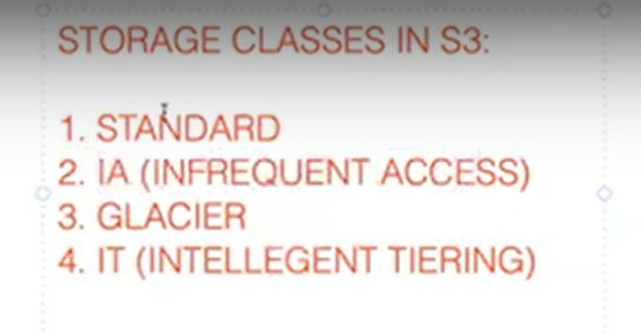

Slide 46
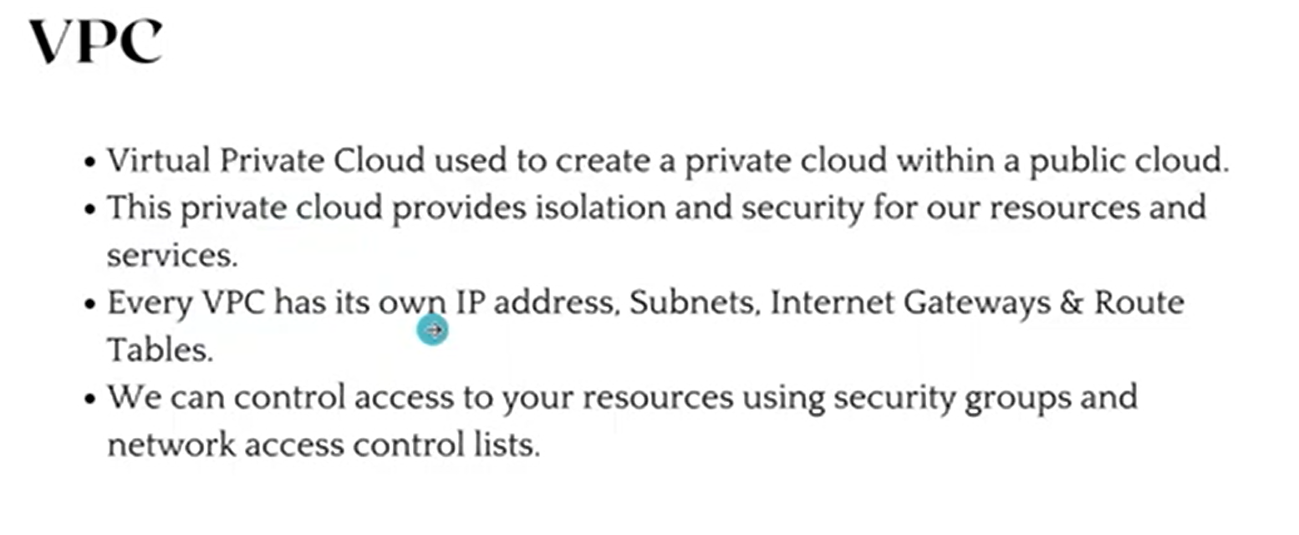

Slide 47
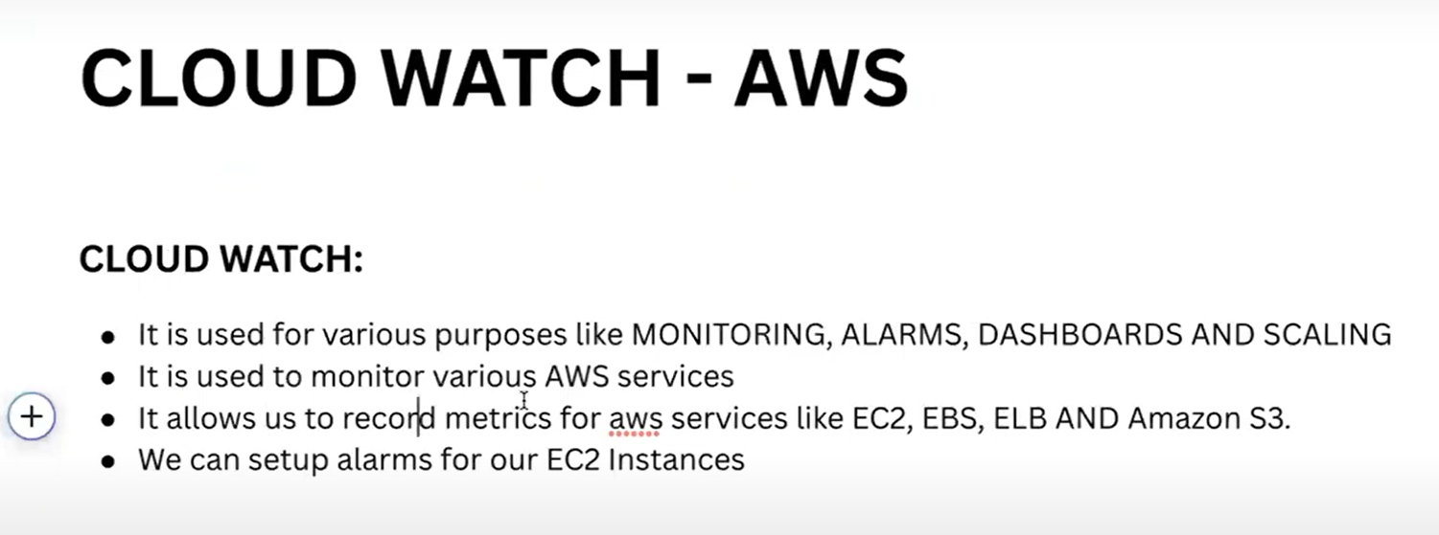

Slide 48
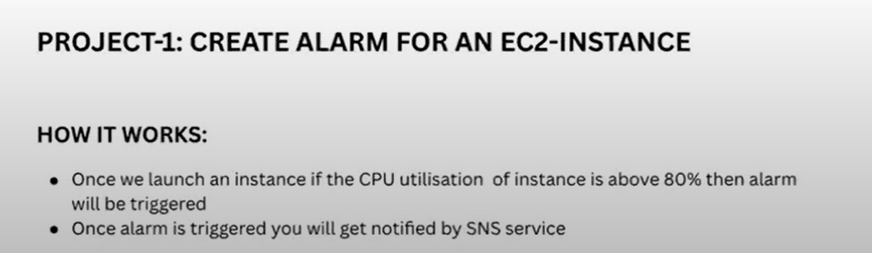

Slide 49
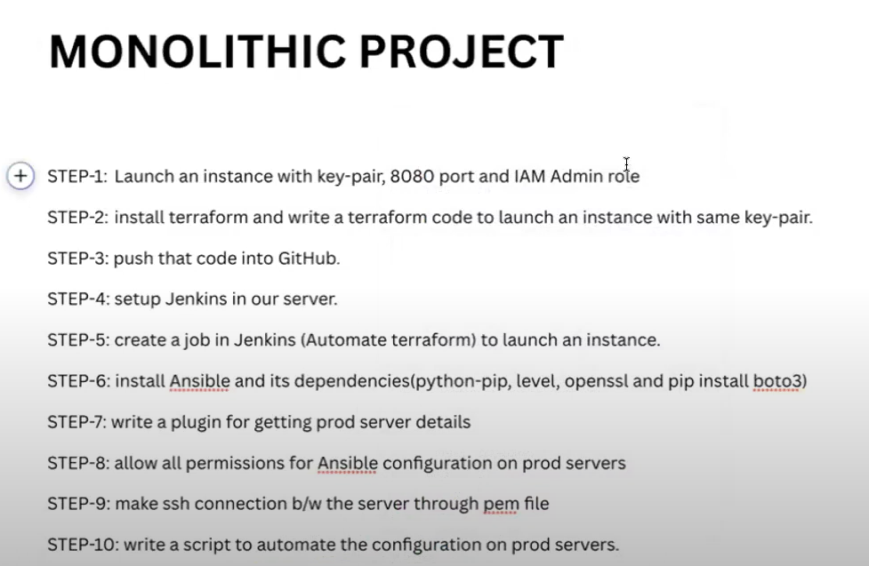

Slide 50
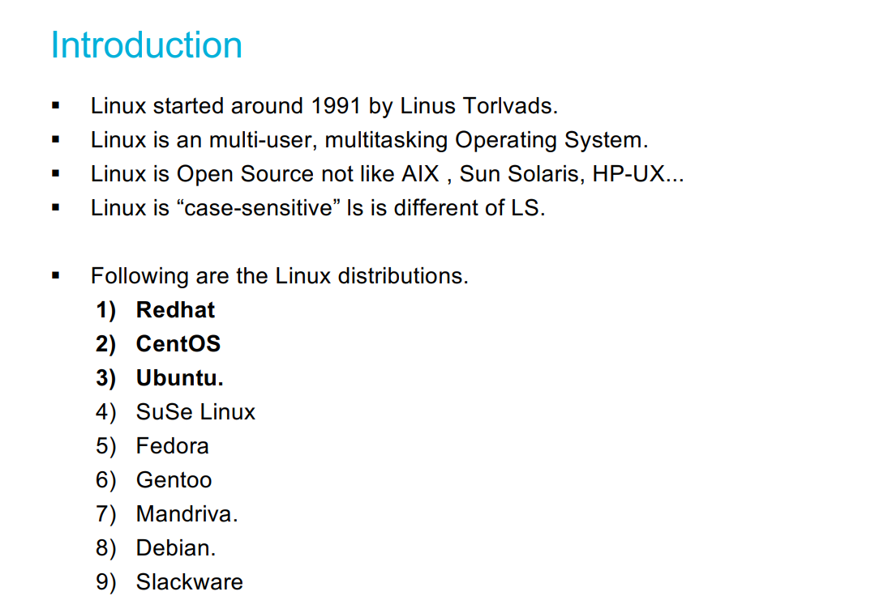
LINUX

Slide 51
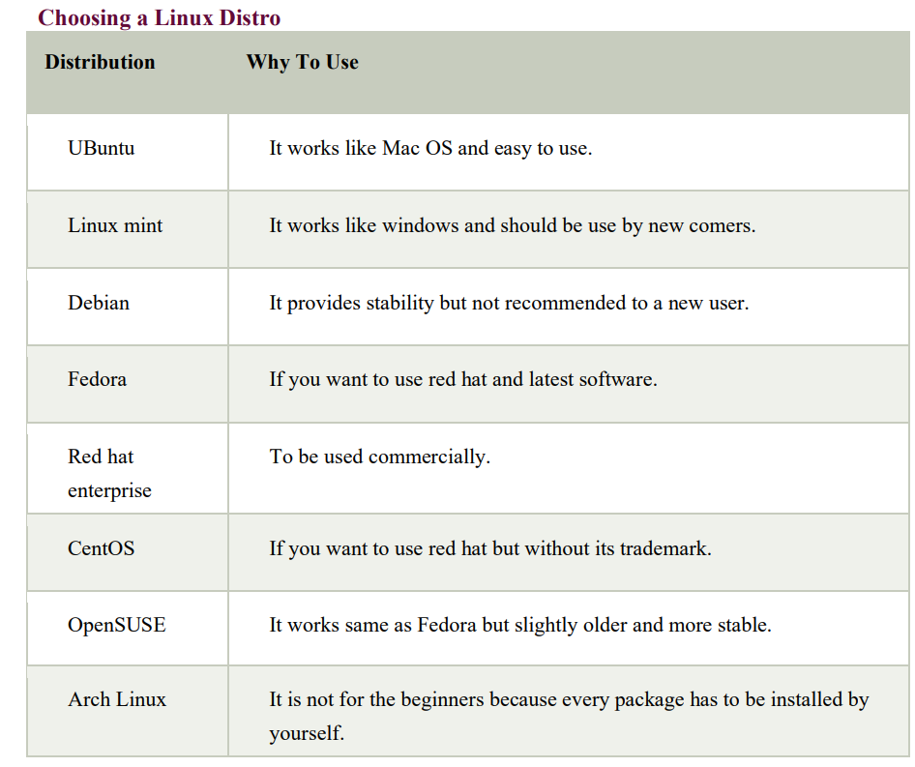

Slide 52
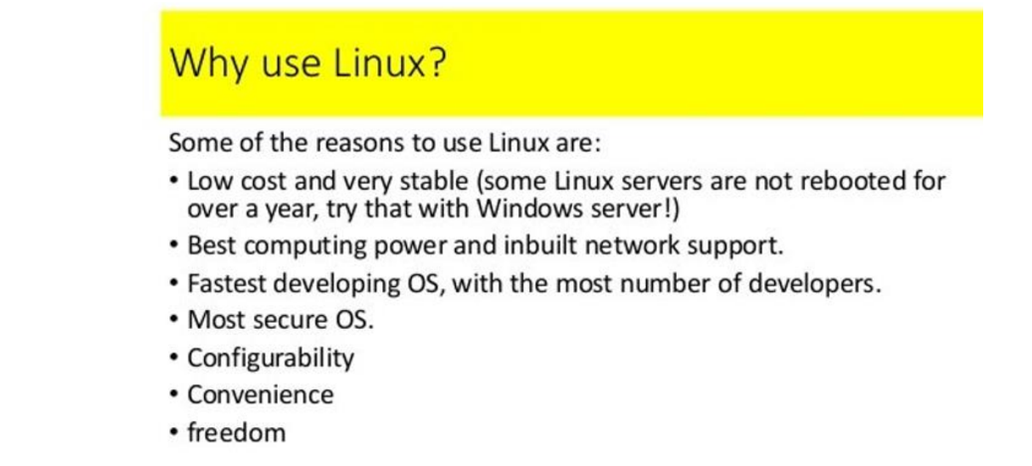

Slide 53
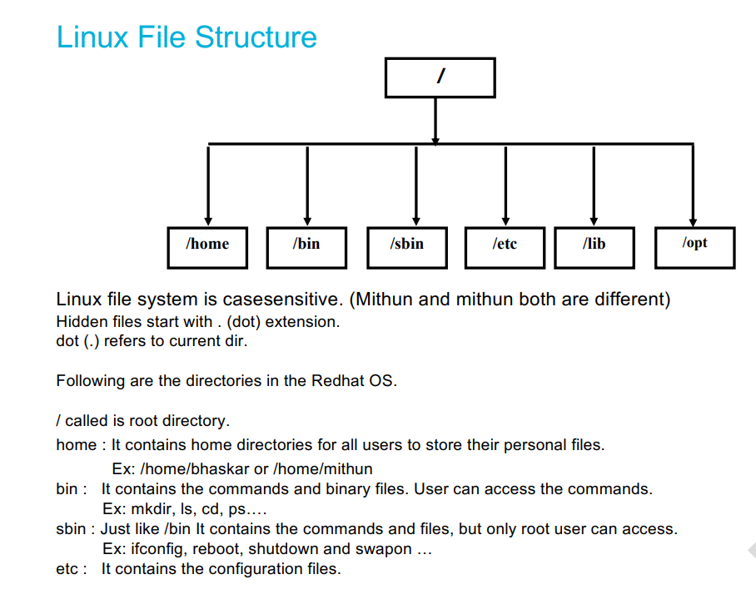

Slide 54
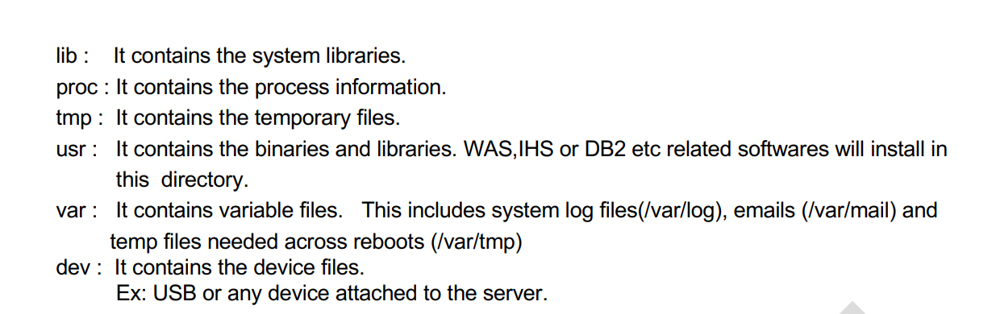

Slide 55
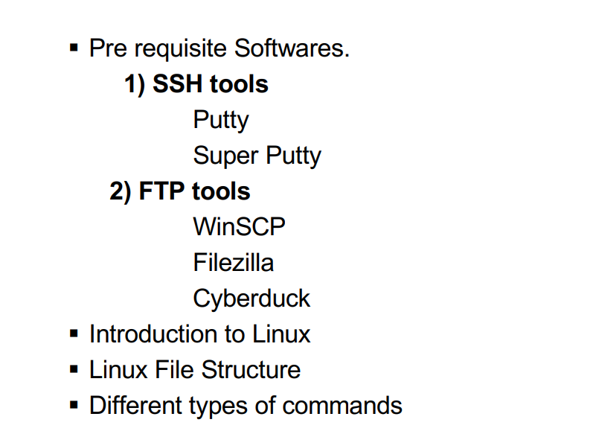
Linux

Slide 56
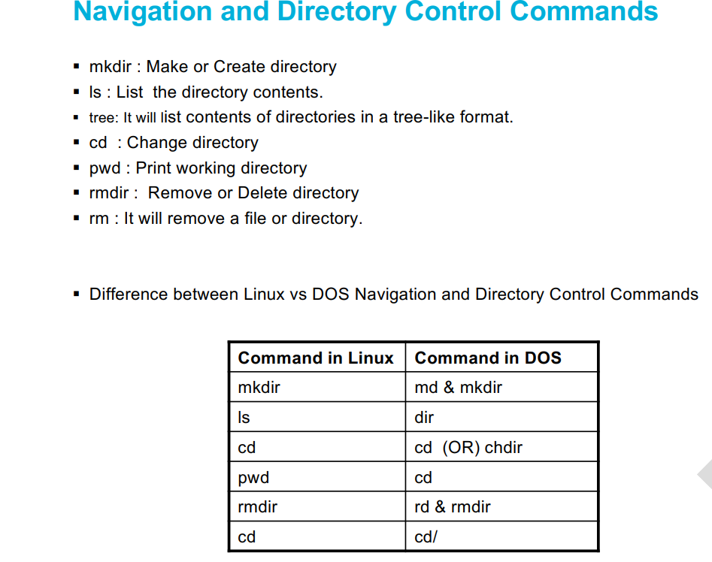

Slide 57


Slide 58


Slide 59


Slide 60


Slide 61


Slide 62


Slide 63


Slide 64

ls –li it will display inode number

Slide 65


Slide 66


Slide 67


Slide 68

Cd: to change working directory

Slide 69


Slide 70


Slide 71


Slide 72


Slide 73


Slide 74


Slide 75


Slide 76


Slide 77


Slide 78


Slide 79


Slide 80


Slide 82


Slide 83


Slide 84


Slide 85


Slide 86


Slide 87


Slide 88


Slide 89
Source Code Management Tools

Slide 90
Popular SCM Tools
Git and Github
Gitlab
SVN
Bitbucket etc…
Most of the companies are using Git and Github.

Slide 91
Git and GitHub PreRequisites (github userid and gitbash)
Open your web browser and go to the GitHub website: https://github.com.
On the GitHub homepage, click on the "Sign up" button located in the upper-right corner.
You will be presented with two options: "Sign up for GitHub" or "Sign up with Google." Choose the option that suits you best.
If you selected "Sign up for GitHub," you will be prompted to enter your desired username, email address, and password. Choose a username that is unique and reflects your identity or the purpose of your account.
If you selected "Sign up with Google," you will be asked to sign in to your Google account, and GitHub will use the associated email address for your account.
After entering your username, email address, and password, click on the "Create account" button.
GitHub may ask you to verify your email address. Check your email inbox for a verification message from GitHub and follow the instructions provided to verify your email.
Once your email is verified, you will be directed to a page where you can choose your personal plan. GitHub offers both free and paid plans, depending on your needs. Choose the plan that suits you best and click on the "Continue" button.
Next, GitHub will ask you a few optional questions about your experience with programming and your intended use of GitHub. You can choose to answer these questions or skip them by clicking on the "Skip this step" link at the bottom of the page.
Congratulations! You have successfully created your GitHub user ID. You can now explore GitHub, create repositories, contribute to projects, and collaborate with other developers.

Slide 92


Slide 93

stages in git

Slide 94


Slide 95


Slide 96


Slide 97


Slide 98


Slide 99


Slide 100


Slide 101


Slide 102


Slide 103
Git and GitHub commands
What is Git and what are its benefits?
Git is a distributed version control system that allows developers to keep track of changes to code and collaborate with others on software development projects. Its benefits include allowing developers to work on code simultaneously without interfering with each other's work, providing a history of changes to the code, and enabling developers to easily revert to previous versions of the code if needed.
What is GitHub?
GitHub is a web-based hosting service for Git repositories. It provides a user-friendly interface for developers to manage their Git repositories, collaborate with other developers, and contribute to open-source projects.
What is a repository?
A repository, also known as a repo, is a collection of files and directories that make up a project, along with the version history of those files.
What is a commit in Git?A commit is a snapshot of the changes made to the code in a repository at a particular point in time. Each commit has a unique identifier and a message describing the changes made.

Slide 104
Git and GitHub commands
What is branching in Git?
Branching is the process of creating a new line of development from an existing branch. It allows developers to work on multiple versions of the same codebase simultaneously, and to experiment with new features without affecting the main branch.
What is a pull request?
A pull request is a mechanism for developers to submit changes to a project hosted on GitHub. It allows other developers to review the changes and suggest improvements before they are merged into the main branch.
How do you resolve merge conflicts in Git?
Merge conflicts occur when two or more developers make changes to the same file or lines of code. To resolve conflicts, developers must manually edit the affected files and choose which changes to keep and which to discard.

Slide 105
Git and GitHub Commands
What is a Git stash?
A Git stash is a mechanism for temporarily saving changes to a repository without committing them. It allows developers to switch to a different branch or work on a different feature without losing their current work.
What is a Git tag?
A Git tag is a label applied to a specific commit in a repository. It is used to mark important points in a project's history, such as release versions or milestones.
What is the difference between Git and SVN?
Git is a distributed version control system, while SVN (or Subversion) is a centralized version control system. Git allows developers to work on code simultaneously and keep track of changes locally, while SVN requires a centralized server to store and manage code changes. Additionally, Git is generally considered to be faster and more flexible than SVN.

Slide 106



Slide 107


Slide 108


Slide 109


Slide 110


Slide 111


Slide 112


Slide 113


Slide 114


Slide 115


Slide 116


Slide 117


Slide 118


Slide 119


Slide 120


Slide 121


Slide 122


Slide 123


Slide 124


Slide 125


Slide 126


Slide 127


Slide 128


Slide 129


Slide 130


Slide 131


Slide 132


Slide 133


Slide 134


Slide 135


Slide 136


Slide 137


Slide 138


Slide 139


Slide 140


Slide 141


Slide 142


Slide 143


Slide 145


Slide 146


Slide 147


Slide 148


Slide 149


Slide 150


Slide 151


Slide 152


Slide 153


Slide 154


Slide 155


Slide 156


Slide 157


Slide 158


Slide 159


Slide 160


Slide 161


Slide 162


Slide 163


Slide 164


Slide 165


Slide 166


Slide 167


Slide 168


Slide 169


Slide 170


Slide 171


Slide 172


Slide 173


Slide 174


Slide 175


Slide 176


Slide 177


